Slide 1
Ballot Paper matters

Slide 2
Assessment of requirement of ballot papers
Categories of ballot paper :
1.Postal ballot paper- Other than service voters
2.EVM ballot paper
3.Tendered Ballot paper
4.Braille paper
Requirement of ballot papers
No. of EVMs to be used including the reserve EVMs
20 ballot papers per Polling Station for tendered ballot papers.
(c) In addition to point (i) & (ii) 10% of the above number may be printed extra for mutilation etc. at the time of fixing the BPs in the B.U., defective BPs.
(d) For postal ballot - electors in preventive detention, voters on election duty, security personnel in election duty, drivers-khalasis in election duty etc. .

Slide 3
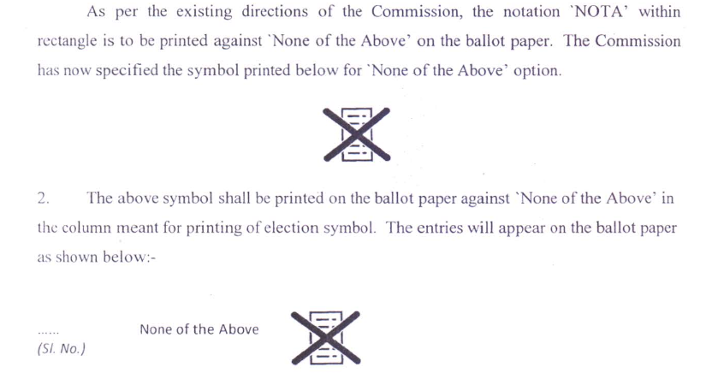
Symbol for NOTA

Slide 4
EVM Ballot Paper
Names of candidates in same language(s) in which the list in Form 7A ( including photograph) has been prepared.
In Lok Sabha Elections EVM Ballots papers shall be printed in White paper.
Name of Constituency in English.
Names of candidates to be arranged in same order as they appear in list of contesting candidates & None of the Above (Form 7A) under 3 categories. The headings of categories not to be printed in ballots.
Form and design of ballots as per directions given Ch. X of the Hand Book for Returning Officers.

Slide 5
EVM Ballot Paper
ECI No. 576/3/2015/SDR dated: 16.03.2015 & 576/3/2015/SDR dated. 21.5.2015
For removing confusion in the minds of the electors where candidates with same or similar names contest from the same constituency, photographs of candidates are to be printed on ballot papers.
The photograph should be of stamp size of 2cm in breadth x 2.5 cm in height.

Slide 6
Tendered ballot papers
20 ballot papers to be sent to each polling station as Tendered Ballot Paper under sealed pack.
Tendered ballot papers shall be in same design and form as the ballot papers to be used in balloting unit of EVM.
The words "Tendered ballot paper" shall be stamped on the back of each such ballot paper.

Slide 7
Printing of Ballot Papers
The list of contesting candidates (Form 7A) to be sent on same day of its finalisation to CEO and the Govt. Press.
Transport and security arrangements to be ensured.
ARO in-charge of printing will leave at once for printing with the relevant documents.
Each bundle will have 20 ballot papers - Not to be stitched - Ballot papers will have consecutive serial numbers.
Exact alignment with BUs to be ensured.

Slide 8
Verification of ballot papers
Ensure that names and symbols have been printed properly and correctly and in correct order.
Ensure that there is no discrepancy in the numbers of ballot papers dispatched by the press and received by RO.
Defective ballots or with duplicate number, or missing number should be entered in register - Also to be published on notice board and intimation to candidates also.
Ballot papers should be kept in safe custody.

Slide 9
Postal Ballot Papers
Postal ballots should be printed at district level at private or govt. printing press.
Printing with due care and with fool proof security arrangements –
Depute an ARO, for strict watch.
Planning and identification of such private presses should be made well in advance.
Ensure that proper slugs, numbering machines, etc. are available at the press.

Slide 10
Postal Ballot Papers
ECI's direction regarding design, form and language of postal ballot paper are given in ECI No. 576/3/2015/SDR dated: 21.5.2015, No. 52/2015/SDR dated: 18.9.2015 & 52/2016/SDR-Vol.I dated: 24.02.2016
In Lok Sabha Elections Postal Ballots shall be printed in White paper.
Postal Ballots when printed in one column shall be of width 4" to 6".

Slide 11
Single column - up to 9 candidates (including NOTA) – In case of indivisible numbers of candidates, e.g. 11 candidates including NOTA, first six candidates will be shown in first column and remaining 5 will be shown in second column, and space at the end of second column for 12th candidate will be completely shaded.
Names of candidates shall be arranged in the same order under 3 categories in which they appear in the list (Form 7A) & the name in the last panel will be None of the Above . Headings of categories should not appear in the ballot paper

Slide 12
Photographs of candidates are also to be printed on postal ballot papers.
For Ballot Papers for Service Electors (ETPBS) - to be printed in the official language of the State and in English (where English is not the official language)
There will be no symbol
SL no | Name of candidate & party affiliation | Photo of candidate | Space for marking

Slide 13
For Postal Ballot Papers (Other categories):
To be printed in the official language of the State and also in English (where English is not the official language)
Symbol to be printed.
Party affiliation not to be printed
Sl No. | Name of candidate | Photo of candidate | Symbol | Col. For marking vote

Slide 14
Language of postal ballot paper
Ref: R.22 of CE Rules 1961 and CH. X of RO Hand Book)–
Counterfoil in English only.
Service postal ballot paper and for other postal ballot papers - Particulars of Candidates and party affiliation in official language of the State and English both.
Particulars in official language of the State will appear first over those in English.
Particulars of Constituency and election in ballot paper will appear in English only.

Slide 15
Printing of postal ballot papers
Printing of postal ballots for other categories should be printed within 72 hours of withdrawals.
Returning Officers shall ensure that uploading of postal ballot papers and the connected papers for service voters on the ETPBS shall be completed by the day following the last date for withdrawal of candidatures.
To be stitched in bundles of 50 ballot papers.
Ensure that Serial number on postal ballot and on its counterfoil are identical.

Slide 16
Preparation of ballot papers in Braille
To be prepared 2 ( two) per polling station,,
To contain particulars on sl. no., name of the candidate, party affiliation,
Also NOTA
To be prepared in the language of the roll and in English

Slide 17
Dummy Ballot Sheets in Braille
Dummy Ballot Sheets in braille to be printed and given to each polling station for use of visually impaired persons.
These Dummy Ballot Sheets in braille will be prepared in regional language (i.e. language printed on actual Ballot Paper) in addition to English‘.
The Dummy Ballot Sheets in braille prepared for every polling station will be certified by the Commissioner of Disabilities of concerned State through his authorized representatives.

Slide 18
Safe custody of undistributed ballot papers
After the issue of ballots, surplus undistributed ballot papers should be kept in safe custody
Such surplus ballot papers may also be used for fresh/adjourned poll.
After completion of the election, surplus ballot papers should be disposed off in the manner prescribed in Ch. XVIII.

Slide 19
Ballot papers for record of ECI and CEO
Two undistributed ballot papers to be sent to ECI, duly cancelled with words "Cancelled for the record in Election Commission“
One ballot paper duly cancelled with the words "Cancelled for the record of Chief Electoral Officer" written on the back of ballot paper under the signature of the RO should be sent to the CEO.

Slide 20
Thanks

